Slide 1
CP1406 – Week 3
Design Principles
Enhancing a Website with Links and Images

Slide 2
Design Principles​ - Design Process​
Somewhere between art, science, and problem-solving ​
The process of creating a design comp ​(“comprehensive dummy”) can be boiled down to:​
discovery ​
exploration​
implementation

Slide 3

Discovery
Meeting and learning about the client(s)
Gathering information, desires, goals…
What questions should you ask a client?

Slide 4
Exploration (using the information from the client)
Put yourself in the shoes of the website visitors and ask yourself what they are looking for
Thinking about buying a product…
what do you need to know before you buy?
Signing up for a service…
where would you learn about the different offerings and which option you need?
What is the clearest title possible for page x?
How many steps does it take to reach page y?

Slide 5
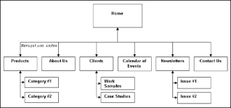
Information Architecture (IA)
Focus on organising the content and flow of the website into a logical structure
Make a list of all the bits and pieces of the site and start arranging them into groups
Use paper, sticky notes or a whiteboard – or a digital tool that lets you move things easily
Turn this into a flowchart
Every box is a page
Every line (arrow) is a link
The order matches the site

Slide 6

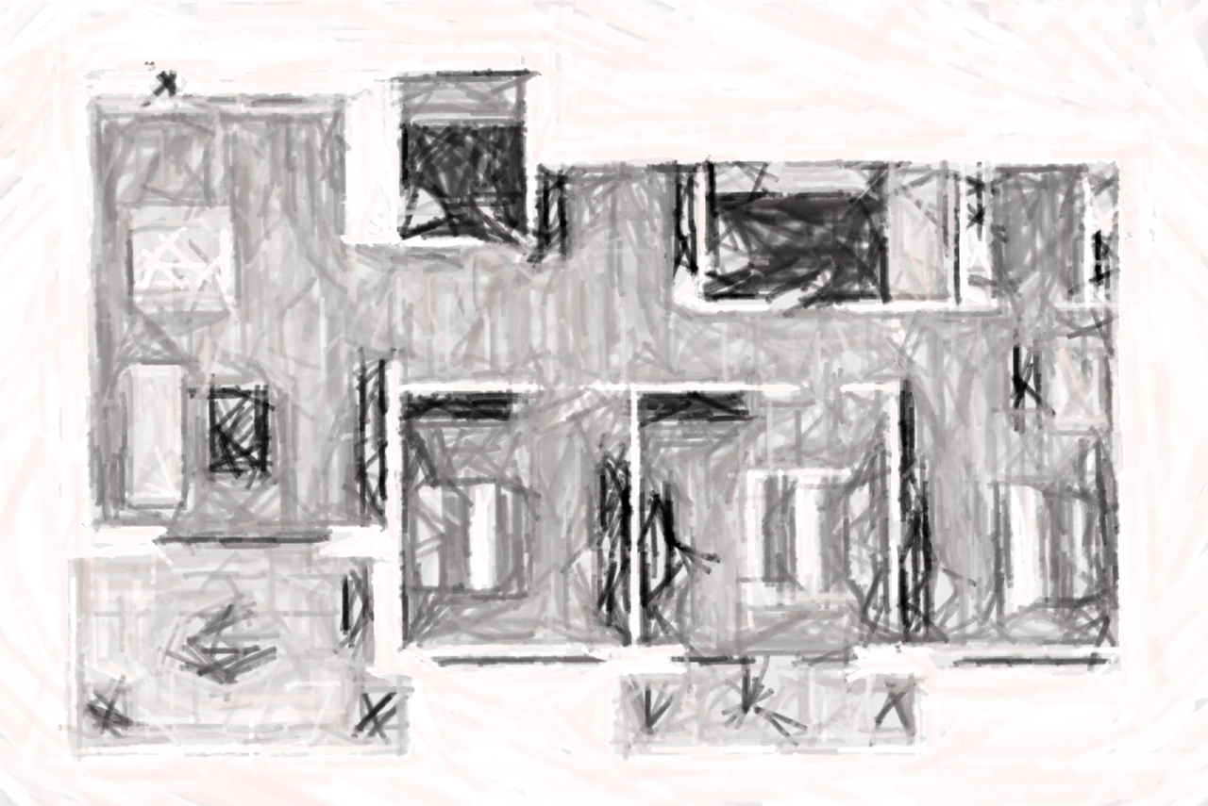

Planning should be useful

Slide 7
Implementation – Creating a layout
Use… paper!
Too easy to lose focus when using a computer
Sketch a few possible layouts
Use (something like) Photoshop to block out the planned areas
Experiment with foreground and background colours
Keep tweaking until you have a comp you can show the client

Slide 8
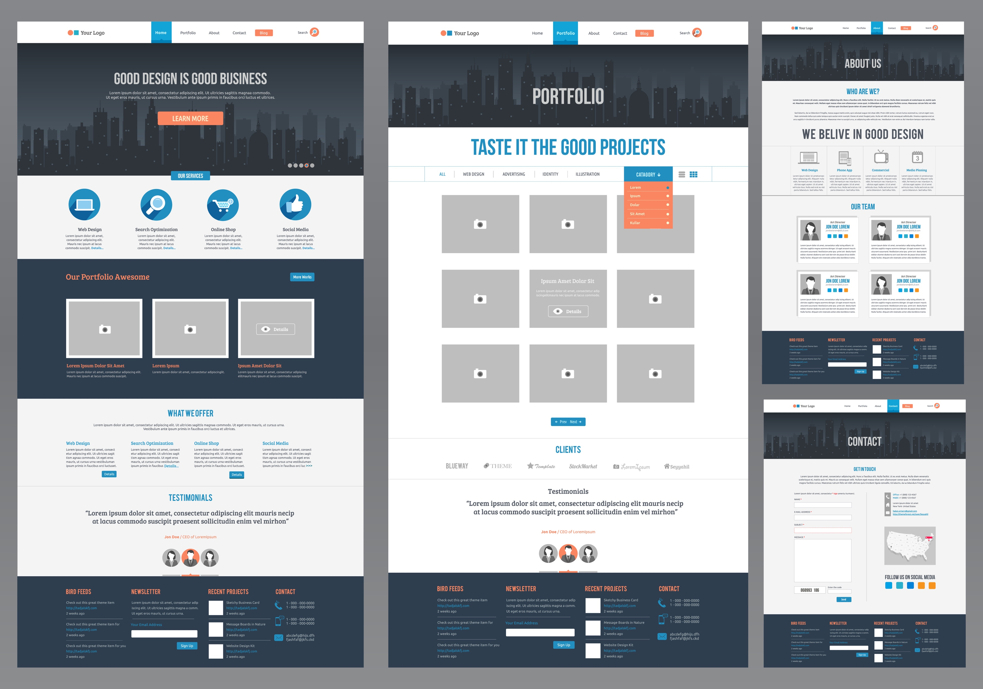


Slide 9
Defining Good (& Bad) Design
Two ways of looking at it:
Strict usability angle
functionality, the effective presentation of information, and efficiency
Purely aesthetic perspective
artistic value and visual appeal of the design
Goal: maximise both

Slide 10
Design is about communication
The elements and functionality of a finished website design should work together, so that:
Users are pleased by the design but drawn to the content
Users can move about easily via intuitive navigation
Users recognise each page as belonging to the site

Slide 11
Cohesive Design
Have a unified/cohesive theme or style
Helps hold the design together across whole site
Users should never think they've left the site
How can we make site designs cohesive?

Slide 12

Notes:
Although the content blocks on these pages are divided differently, there are several visual indicators that let users know that these are pages from the same site. Much of this unity is due to the repetition of the identity and navigation blocks. The consistent use of a very limited color palette (black, gray, yellow, and red) also helps to unify the pages.

Slide 13
How to create a cohesive design
Consistency and repetition create smooth transitions (no "jumps" in layout)
Reinforce identifying elements
e.g., logo in the same top-left spot on every page
Place navigation elements in the same position on each page
Use the same navigation graphics throughout the site
Use a consistent colour scheme

Slide 14

Proximity

Slide 15
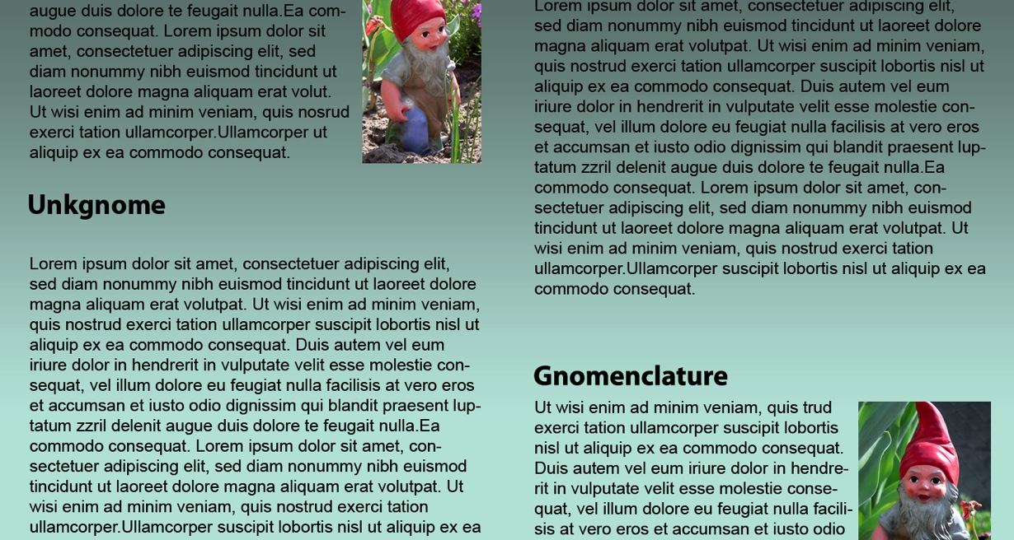
Unity – Proximity
Placing elements closer together (compared to other elements) makes them appear related
Notes:
In the column on the left, the word “Unkgnome” is equidistant from the top and bottom paragraphs. The result is that it looks more like a separator
than a heading for the next paragraph.
In the second column, the “Gnomenclature” heading is placed closer to the paragraph that follows it. In accordance with the rules of proximity, this heading appears to belong to that block of text.

Slide 16
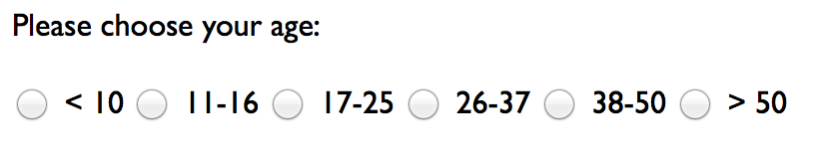
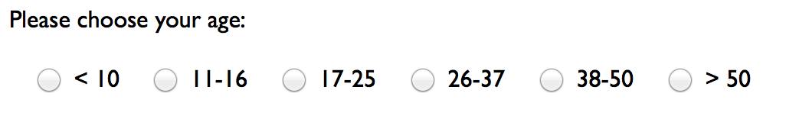

Unity – Proximity
What's wrong with this form?
This is much better:
.proximityDemo input { margin-left: 1em; }
Notes:
The first example has the text labels and radio buttons all the same distance apart, so looking in the middle, you can't tell if the button for, say 17-25 is to its left or right.
Adding just a little margin on one side groups the elements enough to solve this problem.

Slide 17


Images - Introduction
Images (photos, drawings, diagrams, charts…) are used to enhance visual appeal and provide visitors with additional information about a product or service (content)
Images can also help establish a “feel”
Break up text and contribute to the design and aesthetics of a website
Support the purpose of the webpage

Slide 18
Image File Formats
Several file formats exist for storing images
These formats all compress images to create smaller files
Knowing which file format to use for which type of image is important
Format | Pros | Cons | Use for
GIF | Small file size; supports transparency and animation | Limited to 256 colours | Line drawings and animations
PNG | Small file size; supports transparency and millions of colours | Does not support animation | Images that are not digital photos
JPG | Supports millions of colours | Larger file size | Digital photos
SVG | Flexible; scalable; no files needed because graphics are created with code | Not supported by older browsers and not all modern browsers support all SVG features | Shapes, lines, text, and gradients

Slide 19
GIF – Graphics Interchange Format
GIF uses lossless compression technique, meaning that no colour information is discarded when the image is compressed
8-bit colour depth = no more than 256 colors
GIF excels at compressing and displaying flat color areas, making it good for line art and simple color graphics
GIF uses a kind of Run Length Encoding (RLE)
It compresses horizontal runs of the same colour well
Vertical lines, smooth changes (gradients), etc. do not compress well

Slide 20
JPG – Joint Photographic Experts Group
JPG is usually best for photographs or continuous tone images
JPGs are 24-bit RGB images that allow millions of colors
JPGs use lossy compression routine especially designed for photographic images
When the image is compressed, some color information is discarded, resulting in a loss of quality from the original image
This is OK. Many photos can sustain quite a bit of compression while still maintaining image integrity

Slide 21
JPEG Compression
JPEG uses an interesting technique involving:
segmenting the image into 8*8 pixel sections
converting each section to the frequency domain using the Discrete Cosine Transformation (DCT) – because this can be compressed well
compressing the section based on the quality factor, reduces the "high frequency" information, losing quality but saving considerable space
Displaying the image involves the reverse – converting from the data from the frequency to the spatial domain
In short, JPEG compression works best for images that have gradual changes in colour (low frequency data), such as… photographs but NOT text or hard-edged things, etc.
Notes:
More: http://www.ams.org/samplings/feature-column/fcarc-image-compression and http://www.dspguide.com/ch27/6.htm

Slide 22
PNG – Portable Network Graphic
A royalty-free file format intended to replace GIF
GIF uses proprietary (not free) LZW compression
PNG supports transparency and interlacing but not animation
Compresses 8-bit images to smaller file sizes than GIF
PNG uses the lossless DEFLATE compression technique used in ZIP files
Duplicate string elimination - replaces repeated strings with a back-references linking to it (shorter than the repeated string)
Bit reduction using Huffman coding - replaces more commonly used symbols with shorter representations and uses longer representations for less common symbols
Notes:
Because LZW is not free, companies that make software that use it need to pay a fee.
You don't need to pay to use GIF files, but you do to write software that creates them.

Slide 23
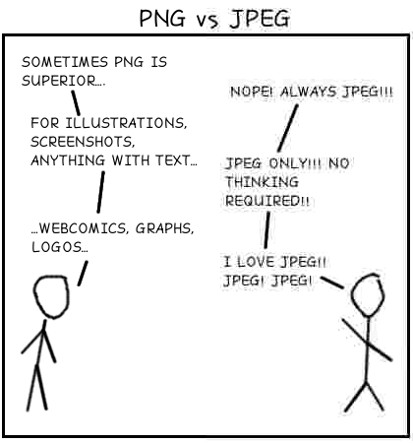

Slide 24
SVG – Scalable Vector Graphic
Vector image format (the others are bitmap)
A language for describing 2D graphics using XML
SVG graphics are scalable to different display resolutions and are printable
Most browsers now support SVG
Example: http://en.wikipedia.org/wiki/File:Flag_of_Australia.svg

Slide 25
Choosing the Right Format
JPG: use JPG for all 24-bit full color photographic images, as well as more complicated graphics that contain color gradients, shadows, and feathering
GIF: the everyday file format for all types of simple colored graphics and line art
GIF’s transparency feature lets you seamlessly integrate graphics into your Web site
… but PNG is mostly preferred

Slide 26
Choosing the Right Format
PNG: you can use PNG as a substitute for GIF; many screenshots, high-color (more than 256) with gradients - but not photographs
Only really need GIF instead of PNG when you want animation
SVG: offers many advantages, excellent for vector images

Slide 27
Image Dimensions and File Size
Pixel: smallest element of light or colour on a device displaying images
Common resolution for laptops is 1366 x 768 pixels
The disadvantage of an image with a high resolution is that it also has a large file size
Use graphic or photo editors to optimise an image with a large file size to reduce its file size and load time

Slide 28
Use Meaningful Image File Names
Many digital cameras use a default file-naming convention, such as IMG001.jpg, which does not describe the image in the photo

Slide 29
HTML Image Tag and its Attributes
The image tag is an empty HTML tag used to add an image to a webpage
<img>
The image tag includes several attributes
src
alt
height
width

Slide 30
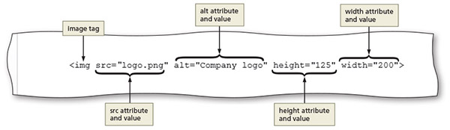
HTML Image Tag and its Attributes
Attribute | Function
src | Identifies the file name of the image to display
alt | Specifies alternate text to display when an image is being loaded Especially useful for screen readers, which translate information on a computer screen into audio output Should briefly describe the purpose of the image in 125 characters or less
height | Defines the height of the image in pixels, which improves loading time
width | Defines the width of the image in pixels, which improves loading time
Table 3–2 Image Element Attributes
Figure 3–12

Slide 31
Exploring Div Elements
Div element defines an area or a division in a webpage
Uses the <div> and </div> tags
Used to structure block-level sections of a webpage
Can be used within the main element to further divide the primary content area into separate sections

Slide 32
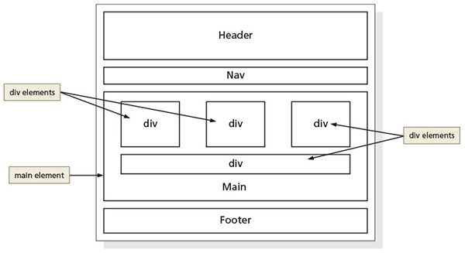
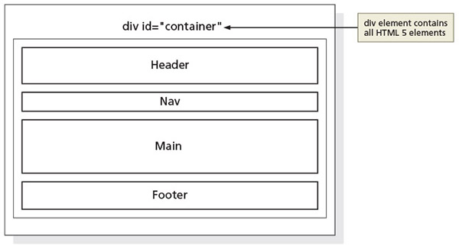
Div Attributes
The div element id attribute identifies a unique area on a webpage and distinguishes it from other page divisions
This will be “targeted” with CSS
Figure 3–21, 22

Slide 33
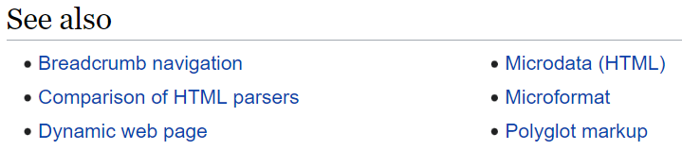
Adding Links to a Webpage
Hyperlink: link on a webpage that allows users to navigate a website and move to another location

Slide 34
Adding Links to a Webpage
Text link: when text is coded as a hyperlink, it appears as underlined text in a color different from the rest of the webpage text
Image link: an image used as a link; some websites display a border around the image

Slide 35
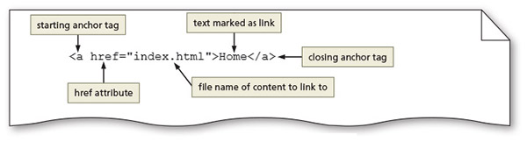
Anchor Element
Used to create a hyperlink on a webpage
The <a> and </a> are the start and the end tags
Include the href attribute to identify the destination webpage, email address, file, telephone number, or other content

Slide 36
Relative Links
Hyperlink that links to other webpages within the same website
Created using an anchor element with an href attribute that designates a path to the webpage/destination
Does not start with http:// (or similar protocol)
Figure 3–30

Slide 37
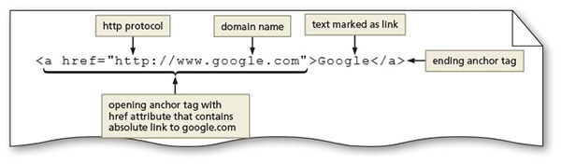
Absolute Links
Hyperlink that links to other webpages outside of a website
Created using an anchor element with an href attribute that designates a website URL
Does start with http:// (or similar protocol)
Figure 3–31

Slide 38
Bookmarks
Some webpages contain a lot of content, making them quite long
Requires excessive scrolling to see all the page content
Bookmarks let website visitors jump to specific areas on the page
To create a bookmark, insert an id attribute and value in the element where you want to include a bookmark
<div id=“lesson1”> The following code creates a link to the bookmark (note the #): <a href=“#lesson1”>

Slide 39
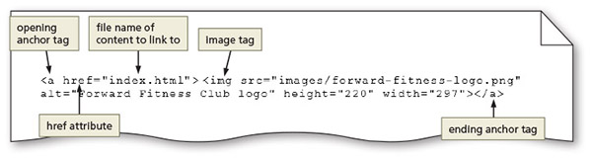
Image Links
Images can be used to link to another page within the site, another website, an email address, or a telephone number
Figure 3–32

Slide 40
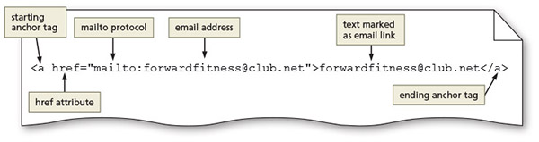
Email Links
Hyperlink that links to an email address
Use anchor elements to link to an email address by including the href attribute followed by "mailto:" and then the email address
Figure 3–33

Slide 41
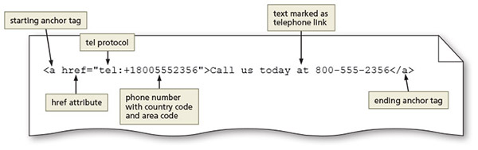
Telephone Links
Hyperlink that links to a telephone number
Use an anchor element to link to a telephone number by including the href attribute, followed by "tel:+1number" where +1 is the international dialing prefix and number is the phone number
Figure 3–35

Slide 42
Adding Lists
Lists structure text into an itemised format
Unordered lists display bulleted items in any sequence
The <ul> and </ul> are the start and end tags for an unordered list
<li> and </li> are the start and end list item tags
The following code creates a bulleted list of two items:
<ul>
<li>First item</li>
<li>Second item</li>
</ul>

Slide 43
Adding Lists
Ordered lists display information in a series using numbers or letters
The <ol> and </ol> are the start and end tags for an ordered list
<li> and </li> are the start and end list item tags
The following code creates a numbered list of two items:
<ol>
<li>First item</li>
<li>Second item</li>
</ol>

Slide 44
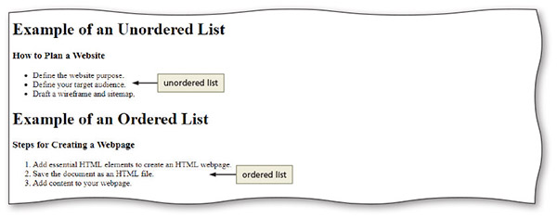
Adding Lists
Figure 3–51

Slide 45
Adding Lists
A description list contains terms and descriptions
The <dl> and </dl> are the start and end tags for a description list
Each term is marked within a pair of <dt> and </dt> tags
Each description or definition is marked between a pair of <dd> and </dd> tags

Slide 46
Adding Lists
The following code creates a description list of two terms and definitions:
<dl>
<dt>First term</dt>
<dd>First definition</dd>
<dt>Second term</dt>
<dd>Second definition – part 1</dd>
<dd>Second definition – part 2</dd>
</dl>

Slide 47
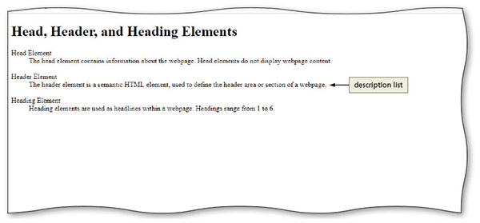
Adding Lists
Figure 3–52

Slide 48
Embedding a Map
Many businesses include a location map embedded within their website
Gives visitors a clear view of the business location
Websites such as maps.google.com and mapquest.com provide online maps
Web developers can visit an online map, enter an address, and then obtain the required code to embed the online map directly within a webpage
https://google-map-generator.com/

Slide 49
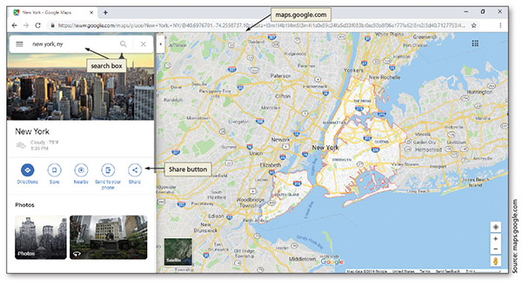
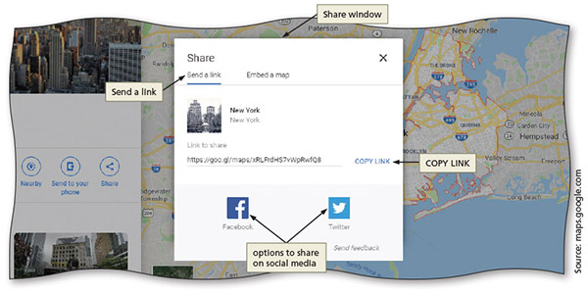
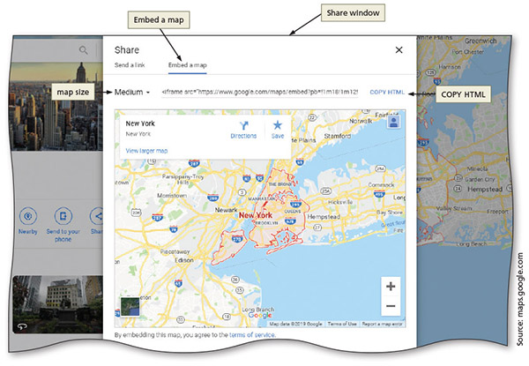
Embedding a Map
Figure 3–67, 68, 69

Slide 50
Chapter Summary
In this chapter, you learned about:
Creating many types of hyperlinks
Inserting new HTML elements, including div elements, image elements, headings, and lists

